Slide 1
Global trends in Income Inequality
Arshad ahmed

Slide 2
Contents
Background
Motivating Questions
Data Analysis
Highlights

Slide 3
Background
Explore global trends in Income Inequality using data from the World Bank from 1980 - 2010
Indicators selected:
Income Share held by top 10% (II)
GDP
Population (Pop)
Derived additional attributes
II / GDP
II / Pop
II / (GDP + Pop)

Slide 4
Motivating Questions
What are the global trends in Income Inequality? How has this changed over time? Which countries are most affected?
Can we derive any additional attributes that allows to segregate this data further?
What is the impact of data transformation on the final results?
How can clustering be used in this context?

Slide 5
Data Analysis
Extraction
Transform:
Visual Analysis Tasks
Fill missing values
Scale
World Bank Indicators
Income share top 10%
GDP, Pop
Choropleths, Proportional Symbol Maps
Cluster Analysis
K-Means, SOM
Cluster vis and stats
Aggregation by country & year

Slide 6
Highlights from the analysis

Slide 7
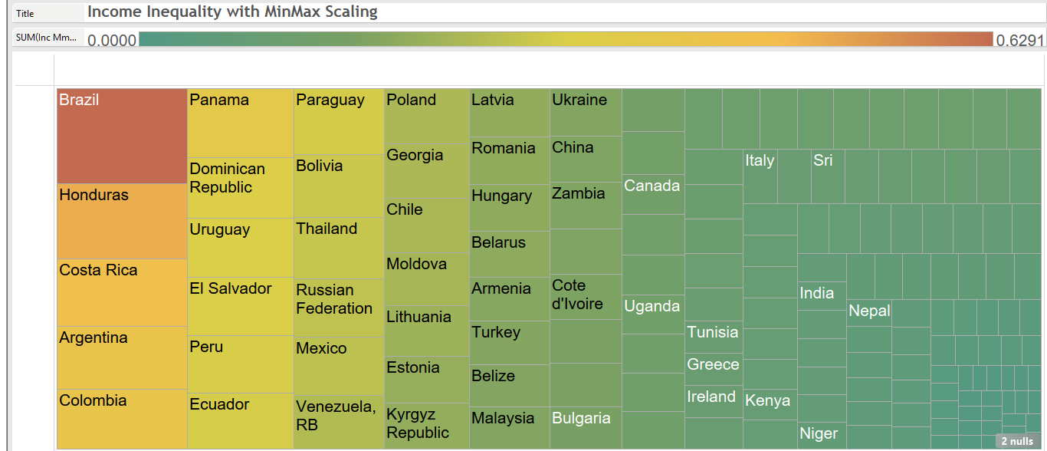
Top countries for high Income Inequality

Slide 8
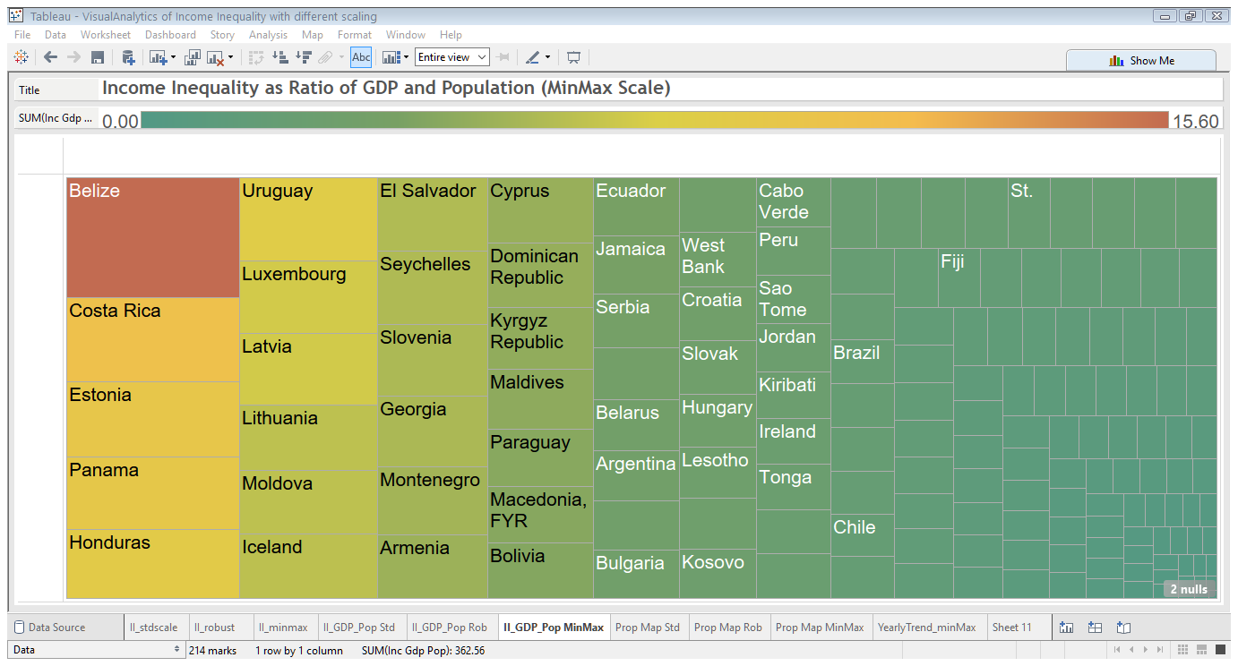
Additional attributes are useful

Slide 9
Highlights
3 distinct clusters (selection shown)
Cluster 0 | Cluster 1 | Cluster 2
Azerbaijan | Argentina | Belize
El Salvador | Australia | Kiribati
Georgia | Austria | Micronesia, Fed. Sts.
Jordan | Bahamas, The | Montenegro
Kosovo | Bahrain | Timor-Leste
Liberia | Bangladesh
Moldova | Barbados
Panama | Belarus
Tajikistan | Belgium
Tonga | Bolivia
 | Bosnia and Herzegovina
 | Botswana
 | Brazil

Slide 10
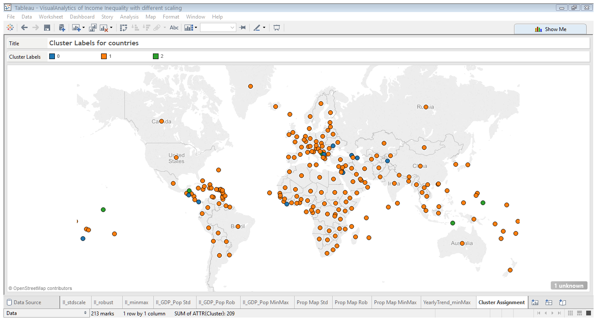
Cluster Assignment

Slide 11
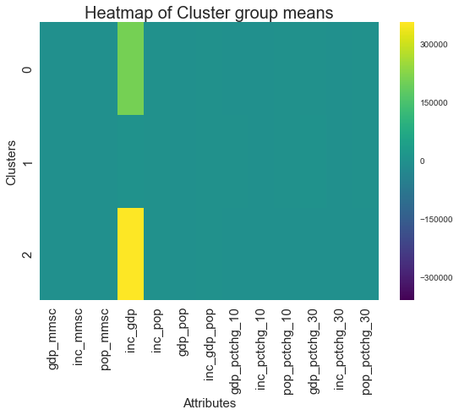
Cluster Stats

Slide 12
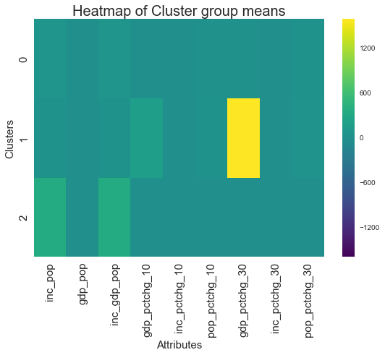
Cluster Stats (II/GDP excluded)

